Slide 1


Slide 2
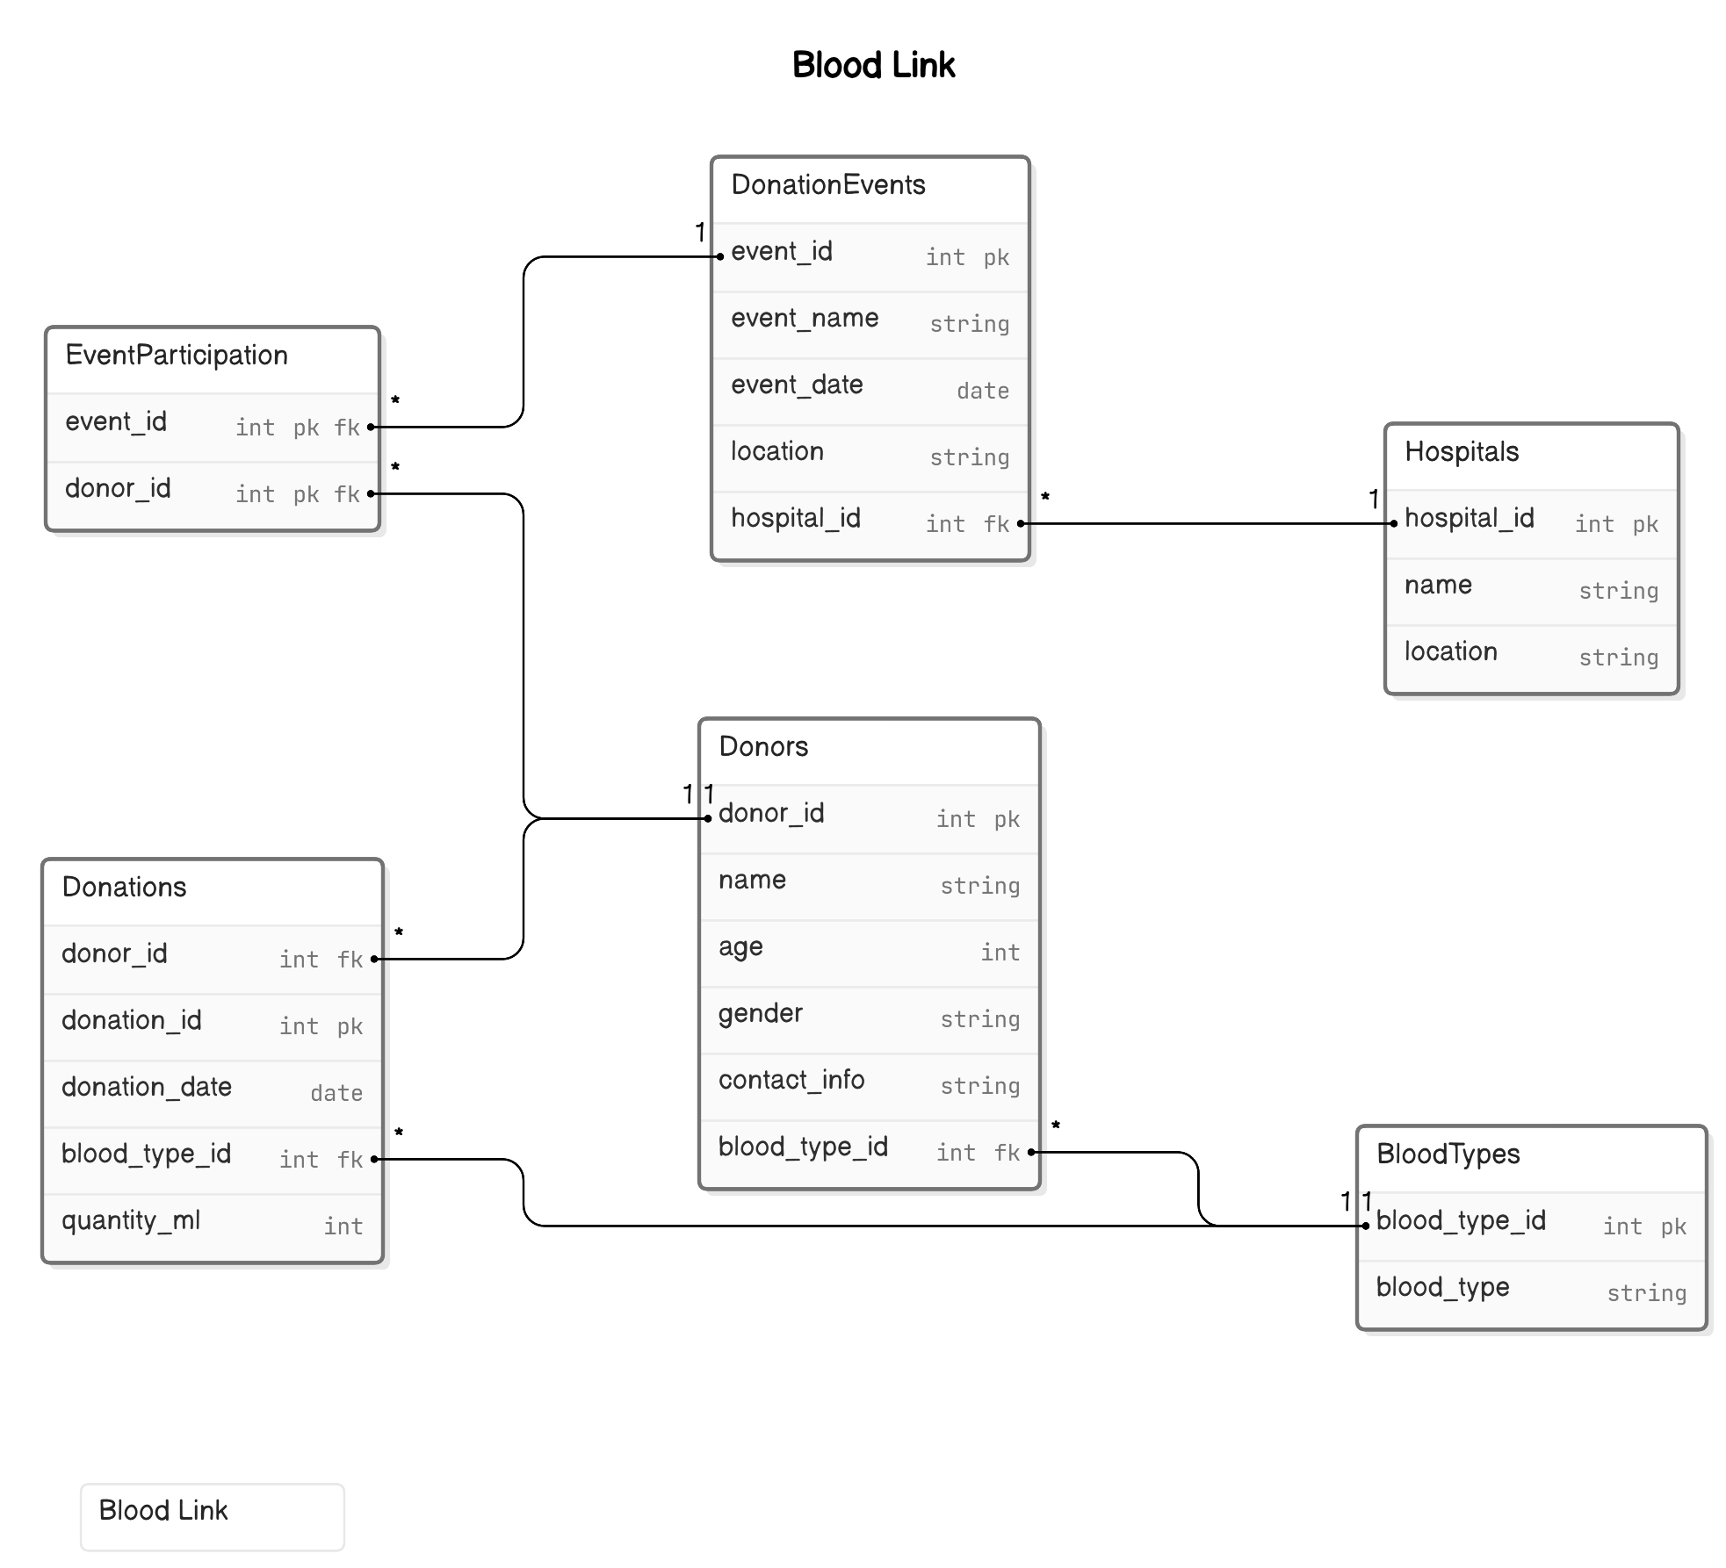
ER Diagram

Slide 3
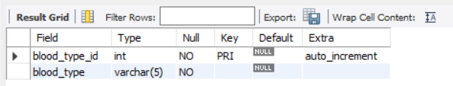
Structure of the table
Blood types Table
This table lists all possible blood types. Table incudes Bloodtype id and Blood type
Syntax; Desc BloodTypes;

Slide 4
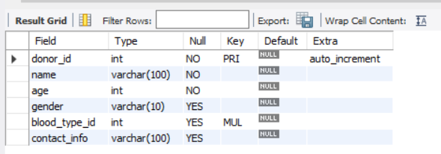
Structure of the table
Donors Table
This table stores detailed information about each blood donor. Table incudes donor-id,name,age,gender,bloodtype-id and contactinfo
Syntax:Desc Donors;

Slide 5
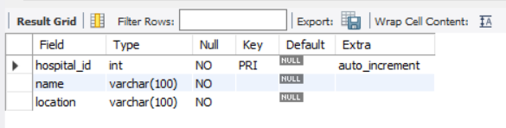
Structure of the table
Hospitals Table
This table contains information about hospitals participating in the blood donation program. Table incudes Hospital-id,name,location.
Syntax:Desc Hospitals;

Slide 6
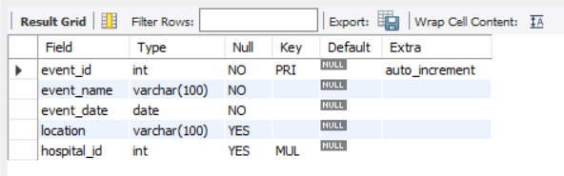
Structure of the table
DonationEventsTable
This table details blood donation events organized by hospital. Table incudes Event-id, Event-name, Event-date,location,hospital-id
Syntax:Desc DonationEvents;

Slide 7
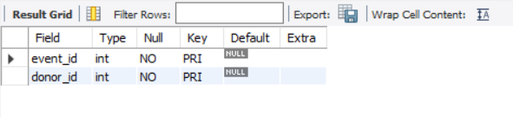
Structure of the table
EventParticipation Table
This table links donors to specific donation events they have participated in Table incudes Event-id, Donor id
Syntax:Desc EventParticipation;

Slide 8
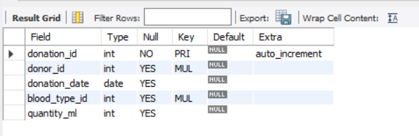
Structure of the table
Donations Table
This table records each donation made by donors Table incudes Donation-id, Donor-id, Donation date, blood-type-id, Quantity-ml
Syntax:Desc EventParticipation;

Slide 9
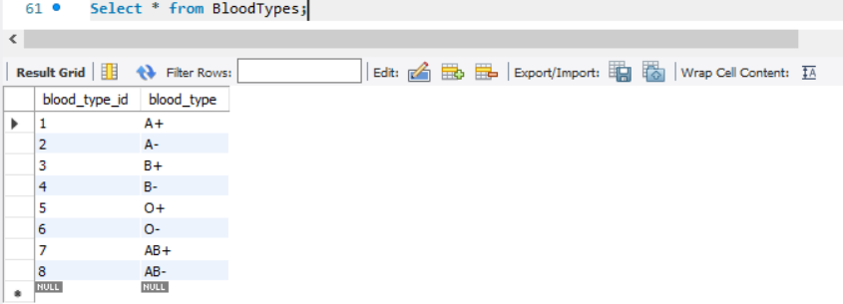
Contents of the Blood Types table
Syntax: Select*from Bloodtypes;

Slide 10
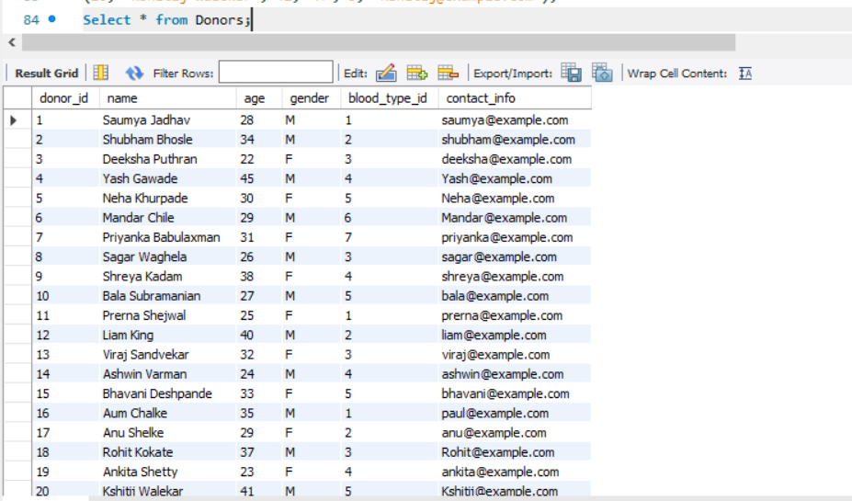
Contents of the Donors table
Syntax: Select*from Donors;

Slide 11
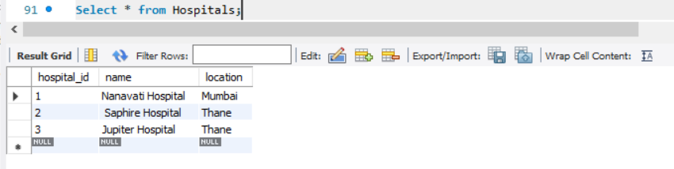
Contents of the Hospitals table
Syntax: Select*from Hospitals;

Slide 12
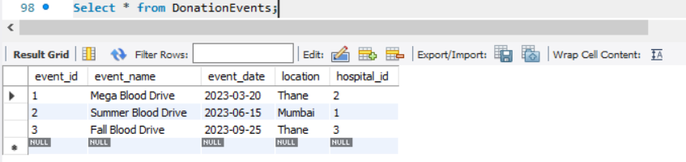
Contents of the Donation Events table
Syntax: Select*from DonationEvents;

Slide 13
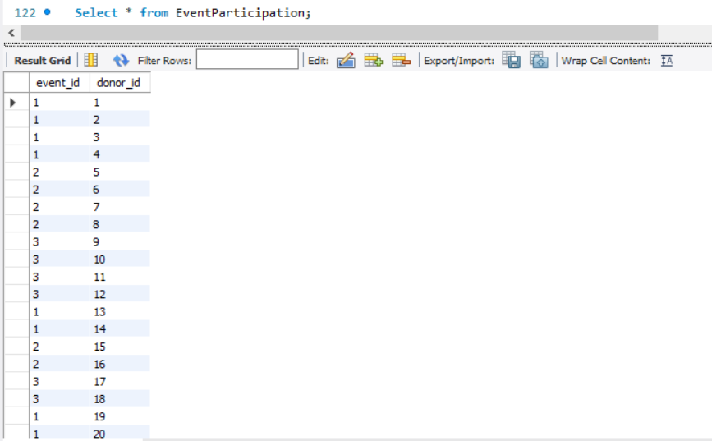
Contents of the Event Participation table
Syntax: Select*from EventParticipation;

Slide 14
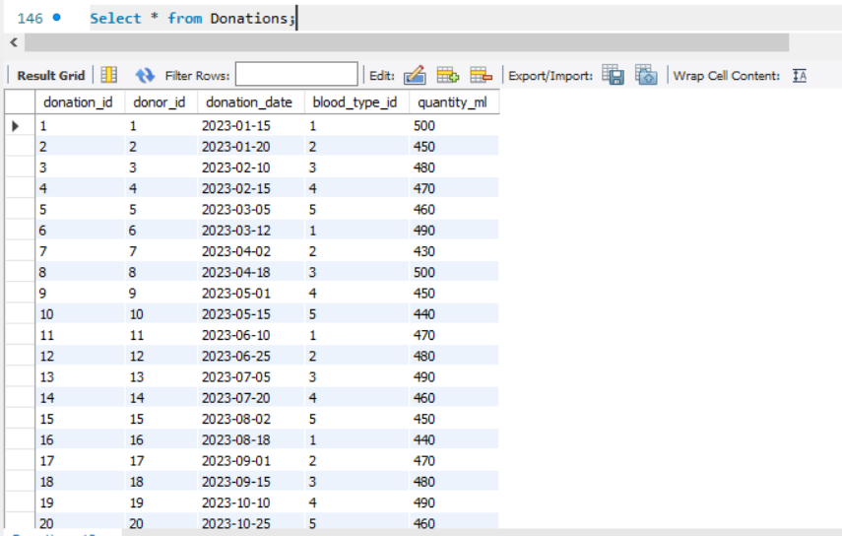
Contents of the Donation table
Syntax: Select*from Donations;

Slide 15
Sub-Query
Sub queries

Slide 16
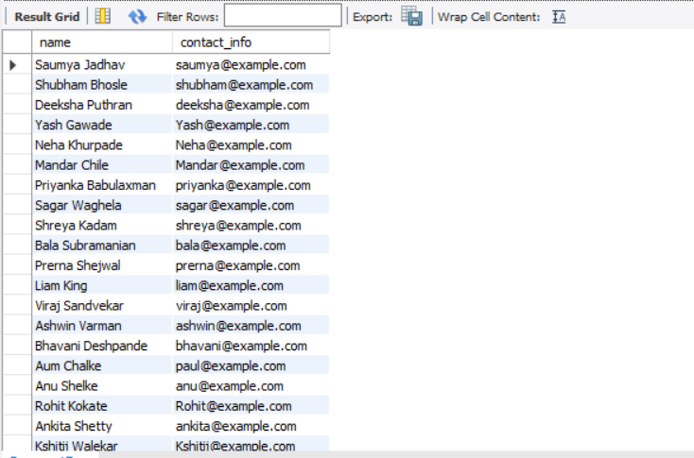
Sub-Query
Display the names and contact information of donors who have donated more than 300 ml of blood in a single donation.
Syntax: SELECT name, contact_info FROM Donors WHERE donor_id IN ( SELECT donor_id FROM Donations WHERE quantity_ml > 300);

Slide 17
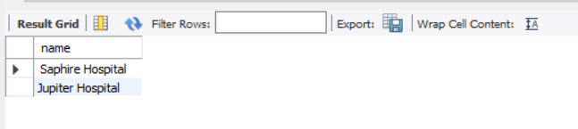
Sub-Query
Show the names of hospitals that have organized donation events in ‘Thane’.
Syntax: SELECT name FROM Hospitals WHERE hospital_id IN ( SELECT hospital_id FROM DonationEvents WHERE location IN ('Thane'));

Slide 18
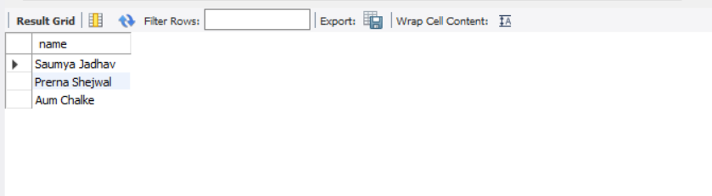
Sub-Query
Find the names of donors who have donated blood for a specific blood type 'A+' Syntax: SELECT name FROM Donors WHERE blood_type_id = (SELECT blood_type_id FROM BloodTypes WHERE blood_type = 'A+');

Slide 19
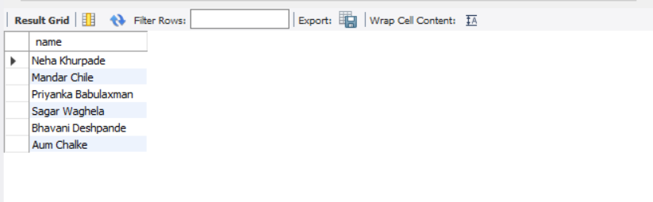
Sub-Query
Find the names of donors who have participated in the ‘Summer Blood Drive' event. Syntax: SELECT name FROM Donors WHERE donor_id IN ( SELECT donor_id FROM EventParticipation WHERE event_id = ( SELECT event_id FROM DonationEvents WHERE event_name = 'Summer Blood Drive' ));

Slide 20
Joins

Slide 21
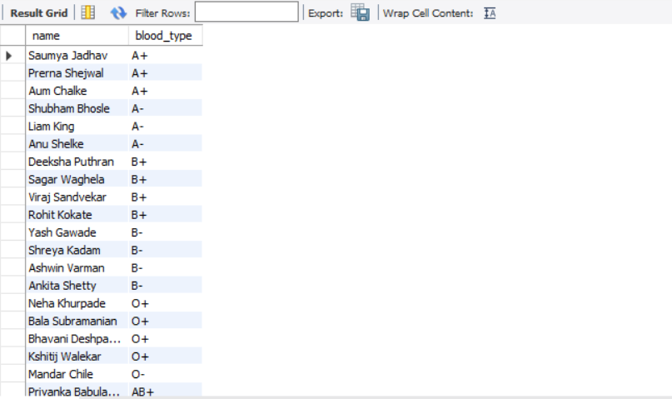
Joins
Find the names of donors along with their corresponding blood types.
Syntax:SELECT Donors.name, BloodTypes.blood_typeFROM DonorsINNER JOIN BloodTypes ON Donors.blood_type_id = BloodTypes.blood_type_id;

Slide 22
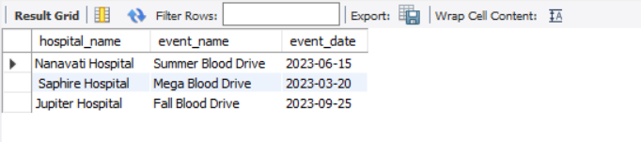
Joins
Find out the hospitals that have organized blood donation events and their corresponding event details, including events without any associated hospital.
Syntax:SELECT Hospitals.name AS hospital_name, DonationEvents.event_name, DonationEvents.event_dateFROM HospitalsLEFT JOIN DonationEvents ON Hospitals.hospital_id = DonationEvents.hospital_id;

Slide 23
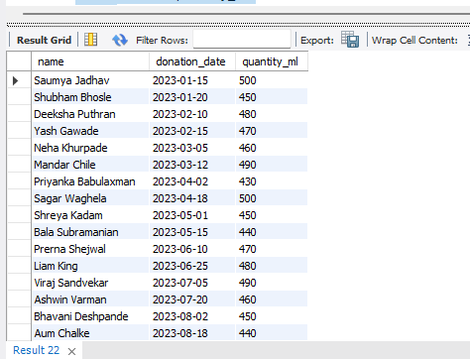
Joins
Get all donors and their donations :
Syntax:SELECT Donors.name, Donations.donation_date, Donations.quantity_mlFROM DonorsRIGHT JOIN Donations ON Donors.donor_id = Donations.donor_id;

Slide 24
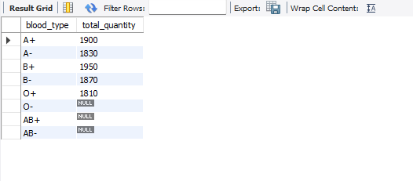
Joins
Get the blood type and how much blood stored(quantity).:
Syntax: SELECT BloodTypes.blood_type, SUM(Donations.quantity_ml) AS total_quantityFROM BloodTypesLEFT JOIN Donations ON BloodTypes.blood_type_id = Donations.blood_type_id GROUP BY BloodTypes.blood_type;

Slide 25
PREPARED BY :
SAUMYA KIRAN JADHAV
IT VEDANT
DS_DA 3-5pm/3rd June

Slide 26
Thankyou

